Slide 1
RELIABLE MESH COMMUNICATION

Slide 2
Objective
Create a mesh network in which each node transmits to each other in a full mesh Network and the received RSSIs are recorded
1
2
4
3
NODES

Slide 3
Challenges:
Transmit as quickly as possible
Record the RSSI of the received packets for future analysis
Scheme has to work also if some nodes disappear
The communications must continue if only 2 nodes are reachable and all the exchanged payloads must be recorded
1
2
1
2
4
3
4
3
NODES
NODES

Slide 4
Communication Scheme
A node is allowed to transmit when he receives a token. The token is the symbol that the channel is assigned to that node. (NO CONTENTION)
Every Δ ms the token will be passed to the following TX node. Trigger will hold the token at the beginning and start the communication in the network. After Δ ms the token will be passed to the following node.
In our scheme we defines 3 types of nodes:
TX node: When a token is received, it will broadcast a packet after Δ ms.
Trigger: In addition at the TX node’s functionality, trigger sends the first packet, so that the communication in the network can start
Listener: Stay in listening mode and record all the exchanged packets
Tx Node
2
1
TRIGGER
3
7
LISTENER

Slide 5
Time
t=t₀
t=t₀+Δ
t=t₀+2Δ
NODE
2
2
2
1
1
1
NODE
3
3
TRIGGER
NODE
3
NODE
7
7
7
LISTENER
LISTENER
LISTENER
Trigger broadcasts a packet at time t_{0.}
Node2 receives the packet from Node1 and send a broadcast message Δ ms after the reception from Node1
Node3 receives the packet from Node1 and wait a time 2x Δ before broadcasting. If in the mean time it receives Node2 packet, the timer is updated with Δ time.
If the broadcast packet coming from node2 never reaches node3, node 3 still will send a packet 2x Δ after the packet received from node1.

Slide 6
Time
t=t₀
t=t₀+Δ
t=t₀+2Δ
NODE
2
2
2
1
1
1
NODE
3
3
TRIGGER
NODE
3
NODE
7
7
7
LISTENER
LISTENER
LISTENER
All the nodes know: (a)number of nodes in the network (b) their NodeID. In this way they can compute the token sequence order.
Each Δ ms the token is passed among nodes.
Synchronization is distributed. No coordinator is necessary.
Just a received broadcast packet is enough to compute the assigned time slot.

Slide 7
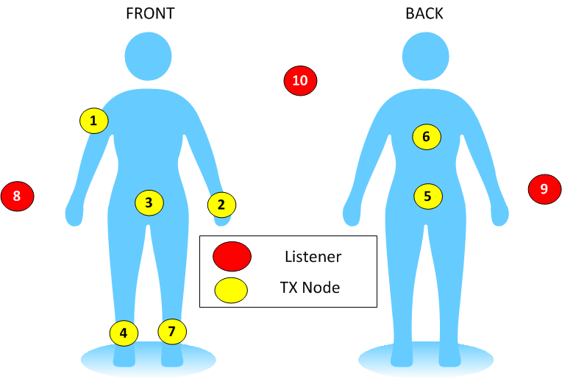
Scheme applied to BAN communications
In BAN some nodes are affected by high path loss which can cause partition of the network.
For example back and waist due to the trunk attenuation sometimes cannot communicate each other for long time. Depends on movements and environment, other nodes suffers similar behavior
Only 2 nodes necessary for the full operation of the network
NO COORDINATOR

Slide 8
Time
t=t₀
NODE
TOTAL_NUM_OF_NODES and Δ (called TIMER_PERIOD_MILLI) are defined in the header file
2
1
Payload Structure:
uint8 NodeID //NodeID from the sender
uint16_t seq_counter [TOTAL_NUM_OF_NODES];
int8_t rssi_value [TOTAL_NUM_OF_NODES];
3
TRIGGER
NODE
NodeID
Seq_Counter[1]
RSSI[1]
Seq_Counter[2]
RSSI[2]
Seq_Counter[3]
RSSI[3]
1
1
Payload Frame
8
Node1 start the communication broadcasting the first packet with payload:
NodeID=1;
Seq_counter[1]= 1 (1st packet transmitted)
RSSI_Value[1]= {} //empty
LISTENER

Slide 9
t=t₀+Δ
TOTAL_NUM_OF_NODES and TIMER_PERIOD_MILLI are defined in the header file
2
Payload Structure:
uint8 NodeID //NodeID from the sender
uint16_t seq_counter [TOTAL_NUM_OF_NODES];
int8_t rssi_value [TOTAL_NUM_OF_NODES];
1
NODE
3
Node2 received the packet from Node1 at time t_{0.}
It keeps the seq number from the packet received from node1 and RSSI value associated in the memory.
At time t₀+Δ Node2 broadcasts the packet with payload:
NodeID=2;
Seq_counter[1]= the last progressive number received from Node1
RSSI_Value[1]= the RSSI associate with last packet received from Node1
8
LISTENER
NodeID
Seq_Counter[1]
RSSI[1]
Seq_Counter[2]
RSSI[2]
Seq_Counter[3]
RSSI[3]
2
1
80
1
Payload Frame

Slide 10
At time t₀+2Δ the node 3 broadcasts a packet with payload:
NodeID=3;
Seq_counter[1]= the last progressive number received from Node1
RSSI_Value[1]= the RSSI associate with last packet received from Node1
Seq_counter[2]= the last progressive number received from Node2
RSSI_Value[2]= the RSSI associate with last packet received from Node2
Seq_counter[3]= its seq_Counter
RSSI_Value[3]= {} //empty
t=t₀+2Δ
2
1
3
NODE
8
NodeID
Seq_Counter[1]
RSSI[1]
Seq_Counter[2]
RSSI[2]
Seq_Counter[3]
RSSI[3]
3
1
70
1
90
1
LISTENER
Node3 received packet :
from Node1 with seq_Counter=1 and RSSI =-70
from Node2 with seq_Counter=1 and RSSI =-90
If Node3 had not receive a message from NodeID=x, he would have left the associated seq_Counter and RSSI fields blank.

Slide 11
t=t₀+3Δ
At time t₀+3Δ node1 broadcasts a packet with payload:
NodeID=1;
Seq_counter[1]= progressive number
RSSI_Value[1]= {}
Seq_counter[2]= the last progressive number received from Node2
RSSI_Value[2]= the RSSI associate with last packet received from Node2
Seq_counter[3]= the last progressive number received from Node3
RSSI_Value[3]= the RSSI associate with last packet received from Node3
2
1
3
8
For example a typical frame payload will appear:
LISTENER
NodeID
Seq_Counter[1]
RSSI[1]
Seq_Counter[2]
RSSI[2]
Seq_Counter[3]
RSSI[3]
1
2
1
75
1
87
Payload Frame
Node 1 received a packet :
from Node2 with seq_Counter=1 and RSSI =-75
from Node3 with seq_Counter=1 and RSSI =-87
Node1 is sending the 2nd packet

Slide 12
Scheme applied to BAN communications
TX node records the signal strength of last packet received from each node and then it broadcast a packet like that:
NodeID
Seq_Counter[1]
RSSI[1]
Seq_Counter[2]
RSSI[2]
Seq_Counter[3]
RSSI[3]
Seq_Counter[7]
RSSI[7]
1
5
4
75
3
87
4
82
Node 1 is sending the 5th packet.
The last packet received from:
Node2 has seq_counter=4 and its RSSI was 75
Node3 has seq_counter=3 and its RSSI was 87
Node7 has seq_counter=4 and its RSSI was 82
It means node1 has not received correctly the last packet from Node 3

Slide 13
t=t₀+3Δ
LISTENER will forward all the received payload to the UART adding the RSSI associated at the packet received:
RSSI associated with NodeID
NodeID=1;
Seq_counter[1]= progressive number
RSSI_Value[1]= {}
Seq_counter[2]= the last progressive number received from Node2
RSSI_Value[2]= the RSSI associate with last packet received from Node2
Seq_counter[3]= the last progressive number received from Node3
RSSI_Value[3]= the RSSI associate with last packet received from Node3
2
1
3
8
LISTENER
NodeID
Seq_Counter[1]
RSSI[1]
Seq_Counter[2]
RSSI[2]
Seq_Counter[3]
RSSI[3]
1
2
1
75
1
87
Payload Frame
Listener 8 received a packet from node1 with RSSI=-60
RSSI
NodeID
Seq_Counter[1]
RSSI[1]
Seq_Counter[2]
RSSI[2]
Seq_Counter[3]
RSSI[3]
60
1
2
1
75
1
87
Payload Frame sent by UART

Slide 14
Listener 8 received a packet from node1 with RSSI=-60
RSSI
NodeID
Seq_Counter[1]
RSSI[1]
Seq_Counter[2]
RSSI[2]
Seq_Counter[3]
RSSI[3]
60
1
2
1
75
1
87
Listener 9 received a packet from node1 with RSSI=-70
RSSI
NodeID
Seq_Counter[1]
RSSI[1]
Seq_Counter[2]
RSSI[2]
Seq_Counter[3]
RSSI[3]
70
1
2
1
75
1
87
Listener 10 did not receive the packet from node 1
For having a complete representation of the BAN propagation conditions, a packet from a listener is enough for having all the information about the mesh network among the node 1-7.
In fact each node report all the packets he received correctly from the other nodes.
The Listeners will add only the RSSI related to the packet that they receives.
Redundant Listeners will avoid that a missed packet from the listener can be interpreted by the post-processing algorithm (Matlab) as packet losts during an entire cycle.

Slide 15
SCHEME ADVANTAGES
A cycle in my experimentation (7 nodes transmitting) takes 60ms. (less than 9 ms for each node). If we consider that in 60ms the propagations conditions has not changed much, we can have sequences of photos of the propagation conditions with time_unit=60ms
The communication scheme will work without coordinator.
The redundant listeners guarantee redundant information about the RSSI received by the nodes.
The scheme is:
FAST
DISTRIBUTED
RELIABLE
It allow to save real time information about the propagation conditions of the environment for long time.
Test done lasted 1 hour (400Ksamples collected = 36MB of data collected by each listener)

Slide 16
SCHEME ADVANTAGES (2)
The scheme is complete customizable for delivering any info (changing the structure of the payload in the header file).
It allows to build database of information about the propagation conditions and any other info added in the payload
A association/disassociation mechanism can be added for other uses
For the BAN characterization, It is configured to use a channel at 2395MHz ( PFLAGS = -DCC2420_DEF_CHANNEL=9 in the makefile). That guarantees no external interference because that band is reserved .

